Slide 1
Servlets
INTRODUCTION

Slide 2










Iconic Representations.......
Coffee Break
Can you Solve?
FAQ
Test your Memory
Objective
Queries
Demo
Recap
Need more Info
Brainstorm

Slide 3
Objectives
Introduction to Servlets
Introduction
HTTP Basics
Servlets
Servlet Architecture and Life-Cycle
HTTP Vs Generic Servlet
JEE Container
Information from Servlets
Fetching Server Information
Fetching Client Information
Setting/Fetching Initial Parameters
Setting/Fetching Application Parameters

Slide 4
Introduction To Web
Web Pages
Static Pages - They are created using HTML,CSS, and Applet.
Dynamic Pages - They are created with the help of scripting languages
Scripting Languages
Client Side - They are created using Java script, VB Script. They are used to perform Ajax, field validations, and event handling executed on client machine (Web Browser)
Server Side - They are created using Servlet, JSP, ASP. They are used to perform Business and DAO actions executed on the server machine (Web Server)

Slide 5
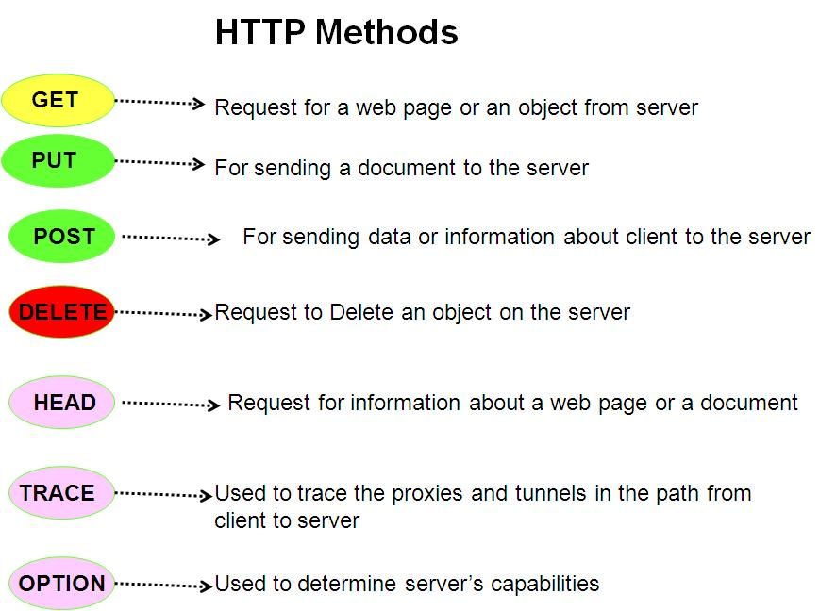
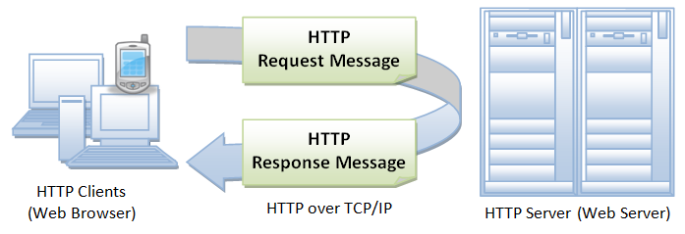
HTTP Basics
HTTP is a request-response oriented protocol.
An HTTP request consists of a request method, a URI, header fields, and a body (which can be empty).
An HTTP response contains a result code, header fields, and a body.
The recognized request methods are GET, HEAD, PUT, POST, DELETE, OPTIONS, and TRACE.
Notes:
Applets :
They run on the client side in web browsers, or for writing Internet applications.
Applets are small programs that are downloaded into a Java Enabled Web Browser, like Netscape Navigator or Microsoft Internet Explorer.
The browser will execute the applet on the client’s machine. The downloaded applet has very limited access to the client machine’s file system and network capabilities.
The Servlet API brings the power of Java to your servers,too.
JavaTM Servlet technology provides web developers with a simple, consistent mechanism for extending the functionality of a web server and for accessing existing business systems.
A servlet can almost be thought of as an applet that runs on the server side.
Servlets are protocol- and platform-independent server side components, which dynamically extend Java enabled servers. They provide a general framework for services built using the request-response paradigm.
Servlets run inside servers. They are Java application components which are downloaded, on demand.

Slide 6
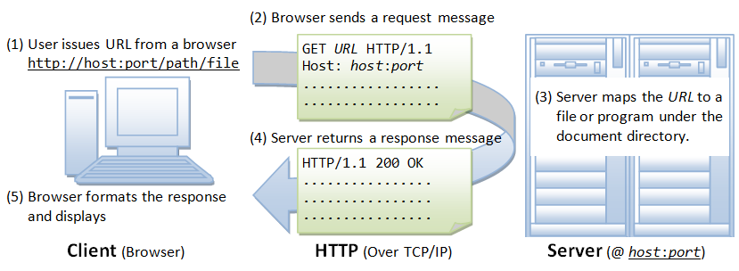
HTTP Basics
Notes:
Applets :
They run on the client side in web browsers, or for writing Internet applications.
Applets are small programs that are downloaded into a Java Enabled Web Browser, like Netscape Navigator or Microsoft Internet Explorer.
The browser will execute the applet on the client’s machine. The downloaded applet has very limited access to the client machine’s file system and network capabilities.
The Servlet API brings the power of Java to your servers,too.
JavaTM Servlet technology provides web developers with a simple, consistent mechanism for extending the functionality of a web server and for accessing existing business systems.
A servlet can almost be thought of as an applet that runs on the server side.
Servlets are protocol- and platform-independent server side components, which dynamically extend Java enabled servers. They provide a general framework for services built using the request-response paradigm.
Servlets run inside servers. They are Java application components which are downloaded, on demand.

Slide 7
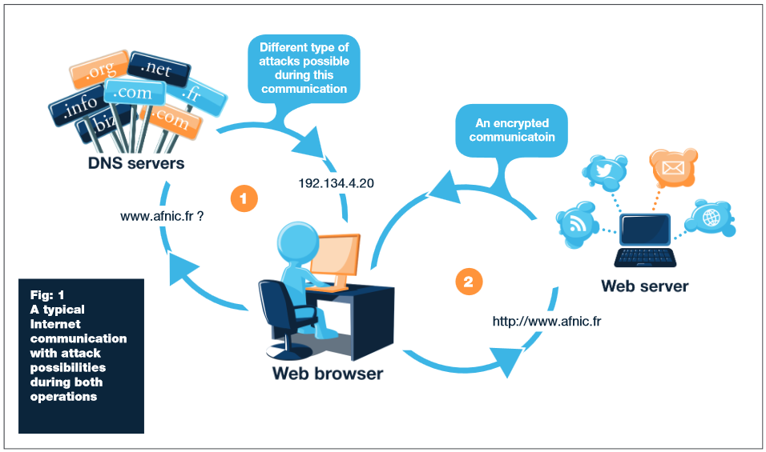
Web Browser and Web Server
Notes:
Applets :
They run on the client side in web browsers, or for writing Internet applications.
Applets are small programs that are downloaded into a Java Enabled Web Browser, like Netscape Navigator or Microsoft Internet Explorer.
The browser will execute the applet on the client’s machine. The downloaded applet has very limited access to the client machine’s file system and network capabilities.
The Servlet API brings the power of Java to your servers,too.
JavaTM Servlet technology provides web developers with a simple, consistent mechanism for extending the functionality of a web server and for accessing existing business systems.
A servlet can almost be thought of as an applet that runs on the server side.
Servlets are protocol- and platform-independent server side components, which dynamically extend Java enabled servers. They provide a general framework for services built using the request-response paradigm.
Servlets run inside servers. They are Java application components which are downloaded, on demand.

Slide 8
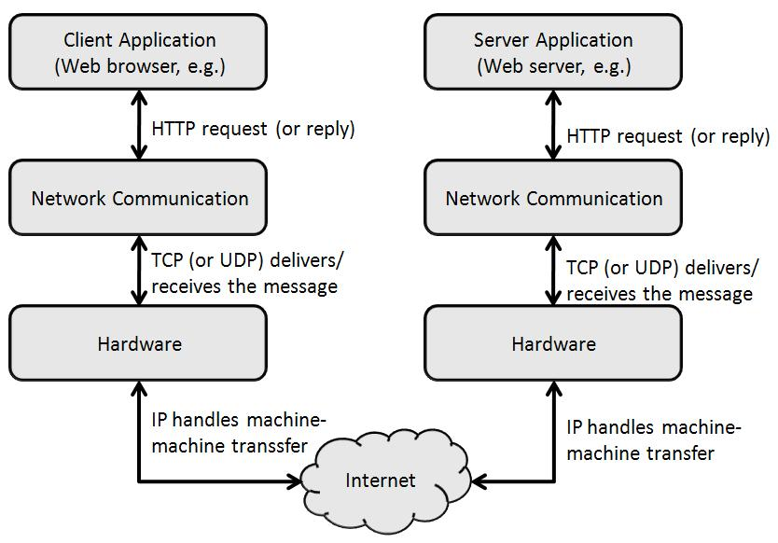
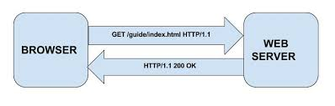
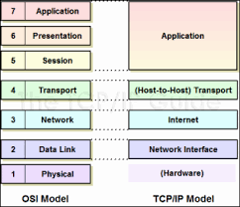
Network layers and Communication
Notes:
Applets :
They run on the client side in web browsers, or for writing Internet applications.
Applets are small programs that are downloaded into a Java Enabled Web Browser, like Netscape Navigator or Microsoft Internet Explorer.
The browser will execute the applet on the client’s machine. The downloaded applet has very limited access to the client machine’s file system and network capabilities.
The Servlet API brings the power of Java to your servers,too.
JavaTM Servlet technology provides web developers with a simple, consistent mechanism for extending the functionality of a web server and for accessing existing business systems.
A servlet can almost be thought of as an applet that runs on the server side.
Servlets are protocol- and platform-independent server side components, which dynamically extend Java enabled servers. They provide a general framework for services built using the request-response paradigm.
Servlets run inside servers. They are Java application components which are downloaded, on demand.

Slide 9
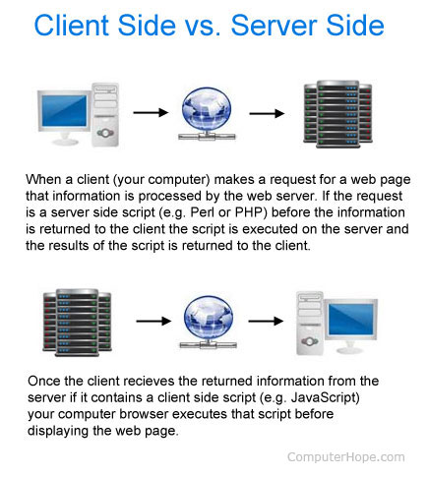
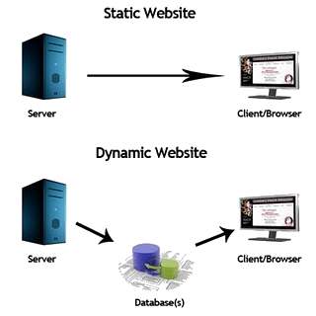
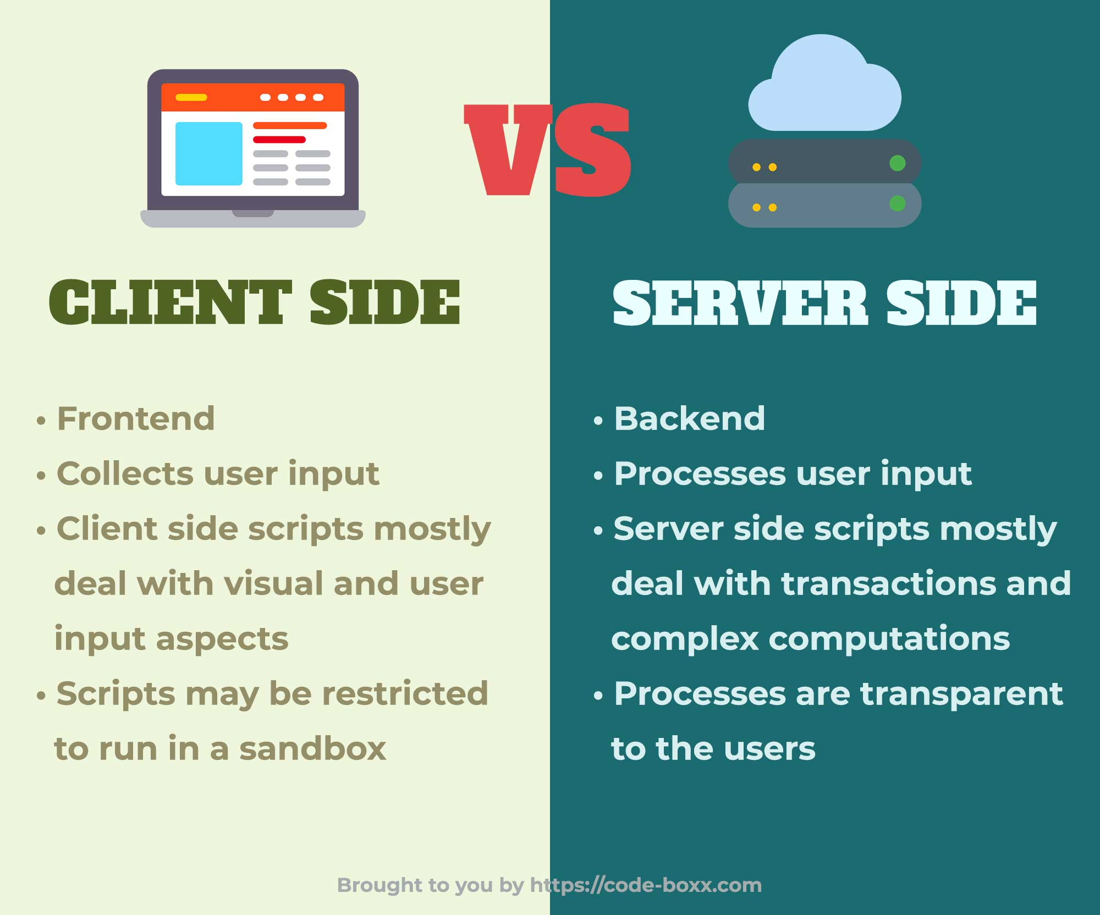
Client Script Vs. Server Script

Slide 10
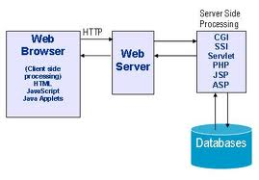
Server Side Scripting Languages
The server – side technologies for generating dynamic pages are:
Common Gateway Interface (CGI)
Active Server Pages (ASP)
Java Servlets
Java Server Pages (JSP)
Distributed Components-Based Technology ( CORBA, DCOM, EJB, RMI, … )

Slide 11
Applets in Server side
Can I use Applets to do server-side programming ?
Applets run on client-side (on the client's JVM (via a Browser Plug-in)).
Big applets require long download time
Applets do not have access to all the system resources
Server-side Java solves problems that applets faces
Code executed on the server side and only the results sent to client
Servlets can access legacy applications and data sources
Notes:
Applets :
They run on the client side in web browsers, or for writing Internet applications.
Applets are small programs that are downloaded into a Java Enabled Web Browser, like Netscape Navigator or Microsoft Internet Explorer.
The browser will execute the applet on the client’s machine. The downloaded applet has very limited access to the client machine’s file system and network capabilities.
The Servlet API brings the power of Java to your servers,too.
JavaTM Servlet technology provides web developers with a simple, consistent mechanism for extending the functionality of a web server and for accessing existing business systems.
A servlet can almost be thought of as an applet that runs on the server side.
Servlets are protocol- and platform-independent server side components, which dynamically extend Java enabled servers. They provide a general framework for services built using the request-response paradigm.
Servlets run inside servers. They are Java application components which are downloaded, on demand.

Slide 12
Introduction CGI
Common Gateway Interface (CGI)
Provides the ability to generate HTML pages dynamically.
Limitations with CGI:
Response time is high, the creation of an OS Shell is an heavy weight activity
CGI is not scalable
Not always secure or object-oriented
No separation of presentation and business logic
Scripting languages are often platform-dependent
Perl 1
Browser 1
Web
Server
Perl 2
Browser 2
Browser N
Perl N
Notes:
Applets :
They run on the client side in web browsers, or for writing Internet applications.
Applets are small programs that are downloaded into a Java Enabled Web Browser, like Netscape Navigator or Microsoft Internet Explorer.
The browser will execute the applet on the client’s machine. The downloaded applet has very limited access to the client machine’s file system and network capabilities.
The Servlet API brings the power of Java to your servers,too.
JavaTM Servlet technology provides web developers with a simple, consistent mechanism for extending the functionality of a web server and for accessing existing business systems.
A servlet can almost be thought of as an applet that runs on the server side.
Servlets are protocol- and platform-independent server side components, which dynamically extend Java enabled servers. They provide a general framework for services built using the request-response paradigm.
Servlets run inside servers. They are Java application components which are downloaded, on demand.

Slide 13
Introduction To Servlets
A servlet is a java program that extends an application hosted on a web server.
Handles the HTTP request-response process.
Dynamically generate html pages in response to requests
May also send data in other forms like XML or serialized Java objects
Run in a servlet container and have access to services that the container provides
Client of the servlet can be: Browser,Applet,Java Application,etc….
It is available and runs on all major web and application servers.
HTTP Request
Servlet
Container
Servlet
Browser
HTTP
Server
HTTP Response
Static
Content
Notes:
Applets :
They run on the client side in web browsers, or for writing Internet applications.
Applets are small programs that are downloaded into a Java Enabled Web Browser, like Netscape Navigator or Microsoft Internet Explorer.
The browser will execute the applet on the client’s machine. The downloaded applet has very limited access to the client machine’s file system and network capabilities.
The Servlet API brings the power of Java to your servers,too.
JavaTM Servlet technology provides web developers with a simple, consistent mechanism for extending the functionality of a web server and for accessing existing business systems.
A servlet can almost be thought of as an applet that runs on the server side.
Servlets are protocol- and platform-independent server side components, which dynamically extend Java enabled servers. They provide a general framework for services built using the request-response paradigm.
Servlets run inside servers. They are Java application components which are downloaded, on demand.

Slide 14
Servlets over CGI
Request is run in a separate thread, so faster than CGIs
Scalable, can serve many more requests,
Robust and Object Oriented.
Can be written in Java Programming language.
Platform independent.
Access to Logging Capabilities.
Error handling and Security.
Servlet
Browser 1
Web
Server
Browser 2
Browser N
Notes:
Applets :
They run on the client side in web browsers, or for writing Internet applications.
Applets are small programs that are downloaded into a Java Enabled Web Browser, like Netscape Navigator or Microsoft Internet Explorer.
The browser will execute the applet on the client’s machine. The downloaded applet has very limited access to the client machine’s file system and network capabilities.
The Servlet API brings the power of Java to your servers,too.
JavaTM Servlet technology provides web developers with a simple, consistent mechanism for extending the functionality of a web server and for accessing existing business systems.
A servlet can almost be thought of as an applet that runs on the server side.
Servlets are protocol- and platform-independent server side components, which dynamically extend Java enabled servers. They provide a general framework for services built using the request-response paradigm.
Servlets run inside servers. They are Java application components which are downloaded, on demand.

Slide 15
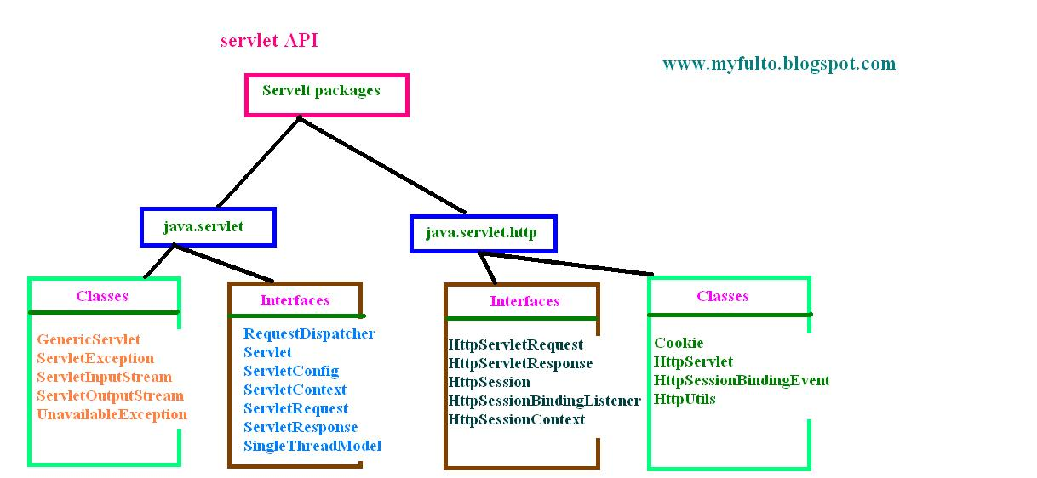

Servlet API
Notes:
Applets :
They run on the client side in web browsers, or for writing Internet applications.
Applets are small programs that are downloaded into a Java Enabled Web Browser, like Netscape Navigator or Microsoft Internet Explorer.
The browser will execute the applet on the client’s machine. The downloaded applet has very limited access to the client machine’s file system and network capabilities.
The Servlet API brings the power of Java to your servers,too.
JavaTM Servlet technology provides web developers with a simple, consistent mechanism for extending the functionality of a web server and for accessing existing business systems.
A servlet can almost be thought of as an applet that runs on the server side.
Servlets are protocol- and platform-independent server side components, which dynamically extend Java enabled servers. They provide a general framework for services built using the request-response paradigm.
Servlets run inside servers. They are Java application components which are downloaded, on demand.

Slide 16
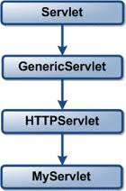
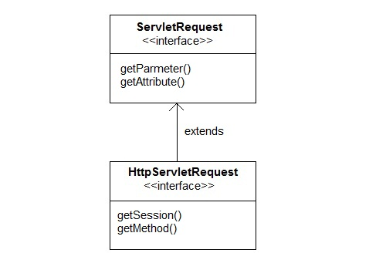
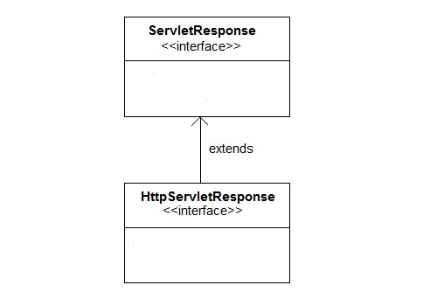
Servlet API
Servlet API:
Servlet API is specified in two packages,
javax.servlet and
javax.servlet.http
Notes:
Applets :
They run on the client side in web browsers, or for writing Internet applications.
Applets are small programs that are downloaded into a Java Enabled Web Browser, like Netscape Navigator or Microsoft Internet Explorer.
The browser will execute the applet on the client’s machine. The downloaded applet has very limited access to the client machine’s file system and network capabilities.
The Servlet API brings the power of Java to your servers,too.
JavaTM Servlet technology provides web developers with a simple, consistent mechanism for extending the functionality of a web server and for accessing existing business systems.
A servlet can almost be thought of as an applet that runs on the server side.
Servlets are protocol- and platform-independent server side components, which dynamically extend Java enabled servers. They provide a general framework for services built using the request-response paradigm.
Servlets run inside servers. They are Java application components which are downloaded, on demand.

Slide 17
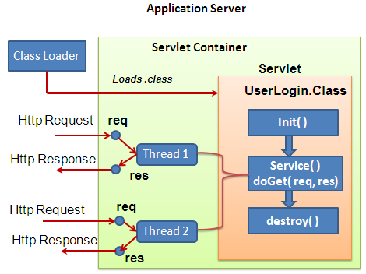
Life Cycle of Servlet
Notes:
Applets :
They run on the client side in web browsers, or for writing Internet applications.
Applets are small programs that are downloaded into a Java Enabled Web Browser, like Netscape Navigator or Microsoft Internet Explorer.
The browser will execute the applet on the client’s machine. The downloaded applet has very limited access to the client machine’s file system and network capabilities.
The Servlet API brings the power of Java to your servers,too.
JavaTM Servlet technology provides web developers with a simple, consistent mechanism for extending the functionality of a web server and for accessing existing business systems.
A servlet can almost be thought of as an applet that runs on the server side.
Servlets are protocol- and platform-independent server side components, which dynamically extend Java enabled servers. They provide a general framework for services built using the request-response paradigm.
Servlets run inside servers. They are Java application components which are downloaded, on demand.

Slide 18
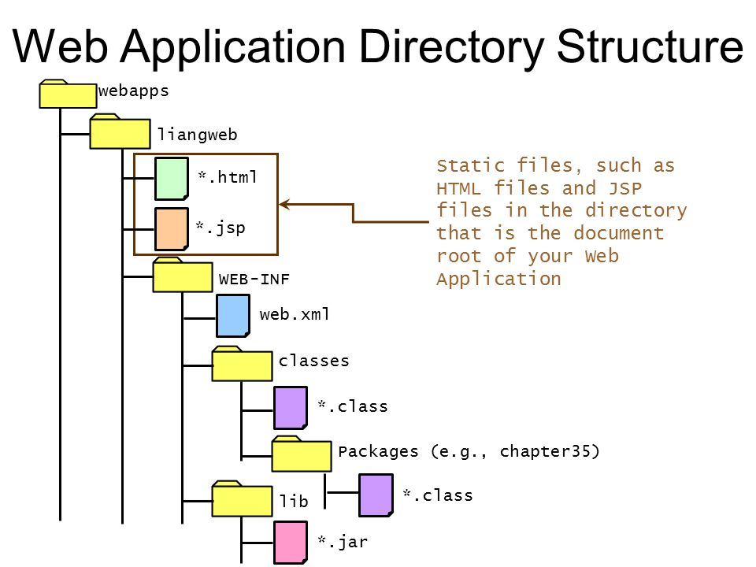
File Structure in Tomcat Server
Notes:
Applets :
They run on the client side in web browsers, or for writing Internet applications.
Applets are small programs that are downloaded into a Java Enabled Web Browser, like Netscape Navigator or Microsoft Internet Explorer.
The browser will execute the applet on the client’s machine. The downloaded applet has very limited access to the client machine’s file system and network capabilities.
The Servlet API brings the power of Java to your servers,too.
JavaTM Servlet technology provides web developers with a simple, consistent mechanism for extending the functionality of a web server and for accessing existing business systems.
A servlet can almost be thought of as an applet that runs on the server side.
Servlets are protocol- and platform-independent server side components, which dynamically extend Java enabled servers. They provide a general framework for services built using the request-response paradigm.
Servlets run inside servers. They are Java application components which are downloaded, on demand.

Slide 19
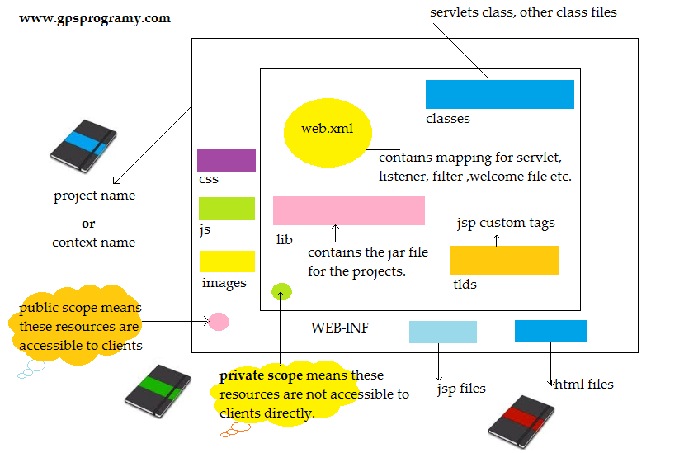

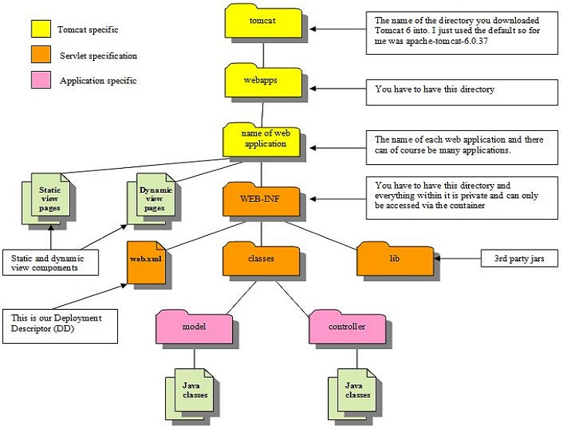
File Structure in Tomcat Server
Servlets over CGI:
Notes:
Applets :
They run on the client side in web browsers, or for writing Internet applications.
Applets are small programs that are downloaded into a Java Enabled Web Browser, like Netscape Navigator or Microsoft Internet Explorer.
The browser will execute the applet on the client’s machine. The downloaded applet has very limited access to the client machine’s file system and network capabilities.
The Servlet API brings the power of Java to your servers,too.
JavaTM Servlet technology provides web developers with a simple, consistent mechanism for extending the functionality of a web server and for accessing existing business systems.
A servlet can almost be thought of as an applet that runs on the server side.
Servlets are protocol- and platform-independent server side components, which dynamically extend Java enabled servers. They provide a general framework for services built using the request-response paradigm.
Servlets run inside servers. They are Java application components which are downloaded, on demand.

Slide 20

MVC Overview
Calling and Passing model object
Response
Validation Class
Controller
Client
Business Class
Request
DAO Class
Store the Request data
Forward the Request
Model
View

Slide 21
MVC Overview
Calling and Passing model object
Response
Validation Class
Controller
Client
Business Class
Request
DAO Class
Store the Request data
Forward the Request
Accessing Model Object
Model
View
Response
Retrieve the Model data

Slide 22
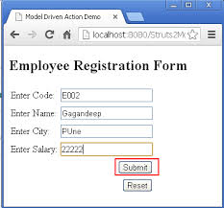

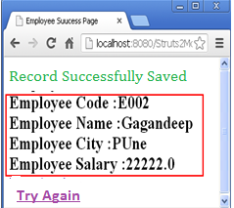
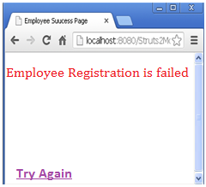
MVC- v1.0 in Web
WEB SERVER
Controller
Validation Class
Request
Business Class
Updating
Model
DAO Class
Code | Name | City | Salary
C002 | Ganandeep | PUne | 22222
Forwarding

Slide 23
Problems in MVC- v1.0
Creating Model Object
WEB SERVER
View Page Name
Controller
Validation Class
Request
Business Class
Updating
Model
DAO Class
Controller Name
Code | Name | City | Salary
C002 | Ganandeep | PUne | 22222
Forwarding
Accessing Model Object
Retrieving
Response

Slide 24
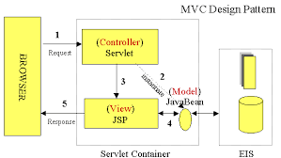
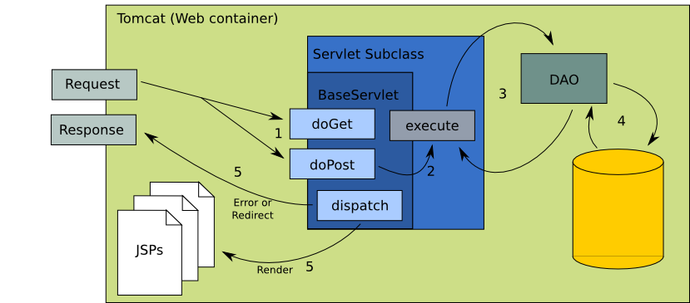
MVC and Servlet Execution
Notes:
Applets :
They run on the client side in web browsers, or for writing Internet applications.
Applets are small programs that are downloaded into a Java Enabled Web Browser, like Netscape Navigator or Microsoft Internet Explorer.
The browser will execute the applet on the client’s machine. The downloaded applet has very limited access to the client machine’s file system and network capabilities.
The Servlet API brings the power of Java to your servers,too.
JavaTM Servlet technology provides web developers with a simple, consistent mechanism for extending the functionality of a web server and for accessing existing business systems.
A servlet can almost be thought of as an applet that runs on the server side.
Servlets are protocol- and platform-independent server side components, which dynamically extend Java enabled servers. They provide a general framework for services built using the request-response paradigm.
Servlets run inside servers. They are Java application components which are downloaded, on demand.

Slide 25
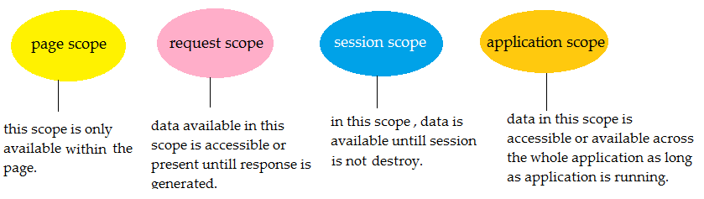
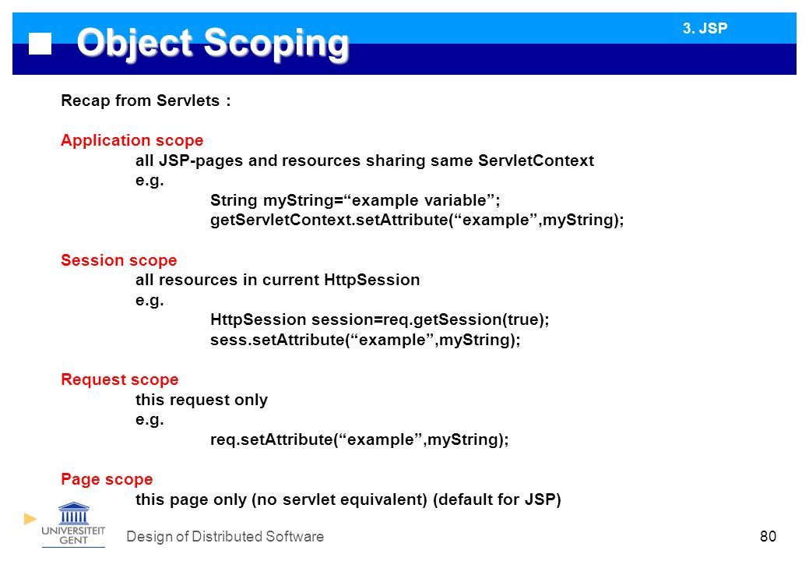
Scope Objects
Notes:
Applets :
They run on the client side in web browsers, or for writing Internet applications.
Applets are small programs that are downloaded into a Java Enabled Web Browser, like Netscape Navigator or Microsoft Internet Explorer.
The browser will execute the applet on the client’s machine. The downloaded applet has very limited access to the client machine’s file system and network capabilities.
The Servlet API brings the power of Java to your servers,too.
JavaTM Servlet technology provides web developers with a simple, consistent mechanism for extending the functionality of a web server and for accessing existing business systems.
A servlet can almost be thought of as an applet that runs on the server side.
Servlets are protocol- and platform-independent server side components, which dynamically extend Java enabled servers. They provide a general framework for services built using the request-response paradigm.
Servlets run inside servers. They are Java application components which are downloaded, on demand.

Slide 26
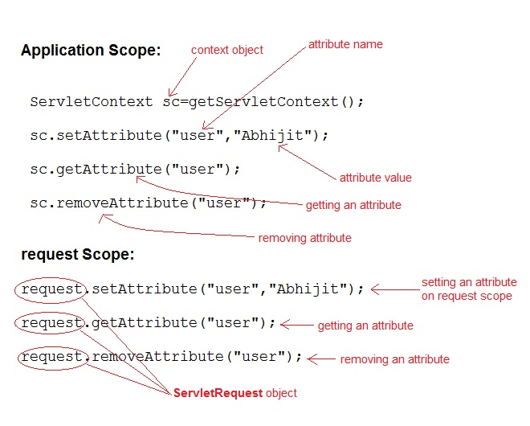
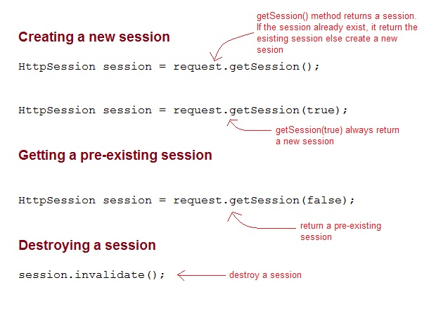
Accessing Scope Objects
Notes:
Applets :
They run on the client side in web browsers, or for writing Internet applications.
Applets are small programs that are downloaded into a Java Enabled Web Browser, like Netscape Navigator or Microsoft Internet Explorer.
The browser will execute the applet on the client’s machine. The downloaded applet has very limited access to the client machine’s file system and network capabilities.
The Servlet API brings the power of Java to your servers,too.
JavaTM Servlet technology provides web developers with a simple, consistent mechanism for extending the functionality of a web server and for accessing existing business systems.
A servlet can almost be thought of as an applet that runs on the server side.
Servlets are protocol- and platform-independent server side components, which dynamically extend Java enabled servers. They provide a general framework for services built using the request-response paradigm.
Servlets run inside servers. They are Java application components which are downloaded, on demand.

Slide 27
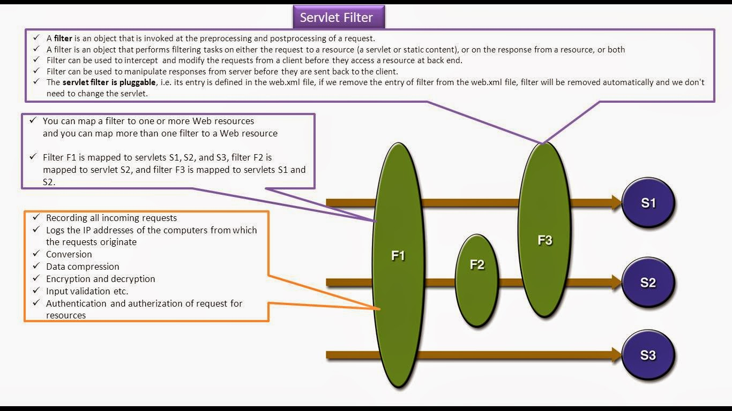
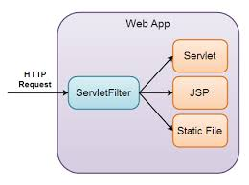
Filter
Notes:
Applets :
They run on the client side in web browsers, or for writing Internet applications.
Applets are small programs that are downloaded into a Java Enabled Web Browser, like Netscape Navigator or Microsoft Internet Explorer.
The browser will execute the applet on the client’s machine. The downloaded applet has very limited access to the client machine’s file system and network capabilities.
The Servlet API brings the power of Java to your servers,too.
JavaTM Servlet technology provides web developers with a simple, consistent mechanism for extending the functionality of a web server and for accessing existing business systems.
A servlet can almost be thought of as an applet that runs on the server side.
Servlets are protocol- and platform-independent server side components, which dynamically extend Java enabled servers. They provide a general framework for services built using the request-response paradigm.
Servlets run inside servers. They are Java application components which are downloaded, on demand.

Slide 28
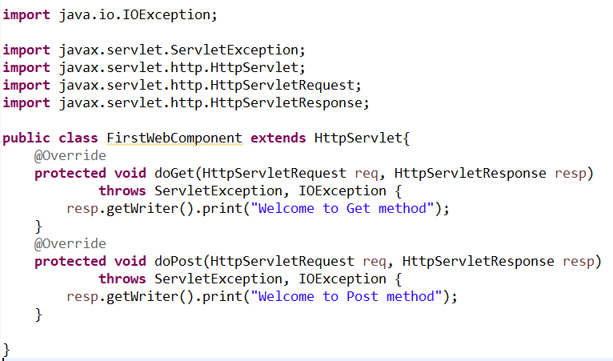
Creating Servlet Class
It should extend HttpServlet
Should Implement the doGet() or doPost() method
Both methods accept two parameters HttpServletRequest HttpServletResponse
Obtain the writer from the response object to write the response and Close the writer
Notes:
Applets :
They run on the client side in web browsers, or for writing Internet applications.
Applets are small programs that are downloaded into a Java Enabled Web Browser, like Netscape Navigator or Microsoft Internet Explorer.
The browser will execute the applet on the client’s machine. The downloaded applet has very limited access to the client machine’s file system and network capabilities.
The Servlet API brings the power of Java to your servers,too.
JavaTM Servlet technology provides web developers with a simple, consistent mechanism for extending the functionality of a web server and for accessing existing business systems.
A servlet can almost be thought of as an applet that runs on the server side.
Servlets are protocol- and platform-independent server side components, which dynamically extend Java enabled servers. They provide a general framework for services built using the request-response paradigm.
Servlets run inside servers. They are Java application components which are downloaded, on demand.

Slide 29
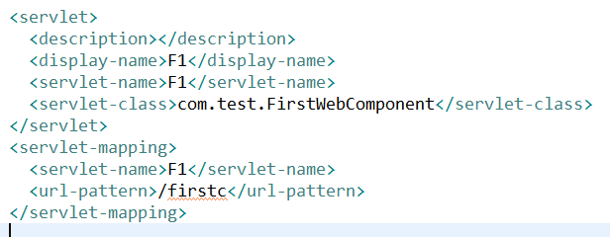
Deployment Descriptor
contains the basic and most important information that is required to deploy a web application (Servlet) .
Without this, the web server would not know, which requests to consider as requests to access this servlet.
Notes:
Applets :
They run on the client side in web browsers, or for writing Internet applications.
Applets are small programs that are downloaded into a Java Enabled Web Browser, like Netscape Navigator or Microsoft Internet Explorer.
The browser will execute the applet on the client’s machine. The downloaded applet has very limited access to the client machine’s file system and network capabilities.
The Servlet API brings the power of Java to your servers,too.
JavaTM Servlet technology provides web developers with a simple, consistent mechanism for extending the functionality of a web server and for accessing existing business systems.
A servlet can almost be thought of as an applet that runs on the server side.
Servlets are protocol- and platform-independent server side components, which dynamically extend Java enabled servers. They provide a general framework for services built using the request-response paradigm.
Servlets run inside servers. They are Java application components which are downloaded, on demand.

Slide 30
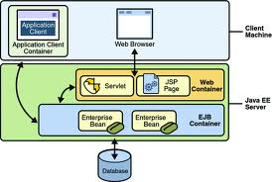
Java EE containers
provide a runtime environment for components that include security, concurrency, life-cycle management, transaction, deployment, and other services.
They can be classified as:
Web containers: Host web components like Servlets and JSP. For example: Tomcat , Sun’s Java Web Server
Application containers: Host business components for developing enterprise-based applications.
For example: BEA System’s Weblogic, IBM’s Websphere Application Server, Redhat’s Jboss.
Notes:
Applets :
They run on the client side in web browsers, or for writing Internet applications.
Applets are small programs that are downloaded into a Java Enabled Web Browser, like Netscape Navigator or Microsoft Internet Explorer.
The browser will execute the applet on the client’s machine. The downloaded applet has very limited access to the client machine’s file system and network capabilities.
The Servlet API brings the power of Java to your servers,too.
JavaTM Servlet technology provides web developers with a simple, consistent mechanism for extending the functionality of a web server and for accessing existing business systems.
A servlet can almost be thought of as an applet that runs on the server side.
Servlets are protocol- and platform-independent server side components, which dynamically extend Java enabled servers. They provide a general framework for services built using the request-response paradigm.
Servlets run inside servers. They are Java application components which are downloaded, on demand.

Slide 31
Information about Servlet
4 Methods to access the information
public String ServletRequest.getServerName() : returns the host name of the server to which the request was sent.
public String ServletRequest.getServerPort() : returns the port number to which the request was sent
public String ServletContext.getServerInfo() : returns the name and version of the server software as: JBossWeb/2.0.1.GA.
public String ServletRequest.getAttribute( String name) : returns the value of the named server attribute as an Object or null if the attribute does not exist. The attributes are server dependent.
Enumeration getInitParameterNames (): It is used to examine all init parameters.
Notes:
Retreiving Information about Servlet
Many a times, you may want to know about the environment in which a web application is running.
You may need to find out about the server that is executing your servlets or who is the client that is sending request.
You may also need information about the requests that the application is handling.
We shall now see a number of methods that provide this information to servlets.

Slide 32
Information about Client
A servlet has the ability to find out about the client machine and for pages requiring authentication, about the actual user.
This information can be used for logging access data, associating information with individual users, or restricting access to certain clients.
Methods are:
Information about client machine:
public String ServletRequest.getRemoteAddr(): retrieves the IP
public String ServletRequest.getRemoteHost(): retrieves the hostname
Information about User:
public String HttpServletRequest.getRemoteUser(): It returns the login of the user, if the user has been authenticated, or null if not.
Enumeration getInitParameterNames (): It is used to examine all init parameters.
Notes:
Retreiving Information about Client
The hostname and IP Address of the client requesting the servlet can be obtained using the HttpRequest object.
getRemoteAddr(): Returns the internet address of the client sending the request. When the client address is unknown, returns an empty string.
getRemoteHost(): Returns the host name of the client sending the request. If the name is unknown, returns an empty string. The fully qualified domain name (e.g. "xyzws.com") of the client that made the request. The IP address is returned if this cannot be determined.
The information comes from the socket that connects the server to the client, so the remote address and hostname may be that of a proxy server. An example remote address might be “192.26.80.1320” while an example of remote host might be “dist.engr.com”.
getRemoteUser () of the HttpServletRequest gives the username of the client. With the remote user’s name, a servlet can save information about each client. Over the long term, it can remember each individual’s preferences. For the short tern, it can remember the series of pages viewed by the client and use them to add a sense of state to a stateless HTTP protocol. A simple servlet that uses getRemoteUser() can greet its clients by name and remember when each last logged in.

